Slide 1

Basic Details of the Team and Problem Statement
Ministry : All India Council for Technical Education(AICTE)
PS Code : DR705 Problem Statement Title : GRAPHICAL PASSWORD AUTHENTICATION Team Name : Access Denied Team Leader Name : Sailesh B Institute Code :
Institute Name : Sri Krishna Institutions
Theme Name : Blockchain & Cybersecurity

Slide 2
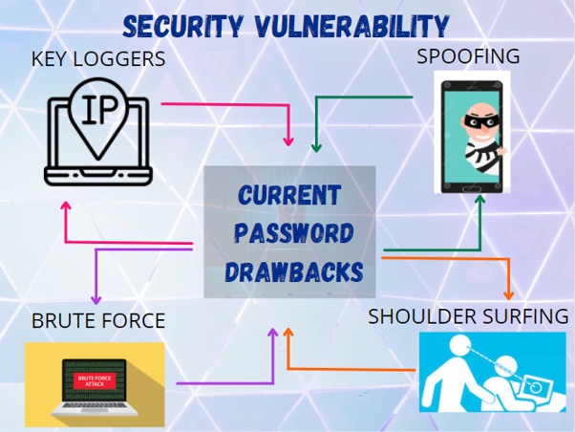
Graphical Password Authentication
Graphical Password Authentication:
Security is playing an important role in todays world.
Our idea is one which enables users to be safe.
A Graphical Password Authentication System is a process in which the passwords are replaced with combinations of graphical images.
Graphical password may offer better security than that of words or numbers.
Working:
Our theme offers a set of random well-shuffled graphical images.
On assembling those in a specific pattern, unlocks the authentication.
It helps to resist Brute force, Spyware, Phishers, etc.
It even helps illiterates to work with passwords.

Slide 3
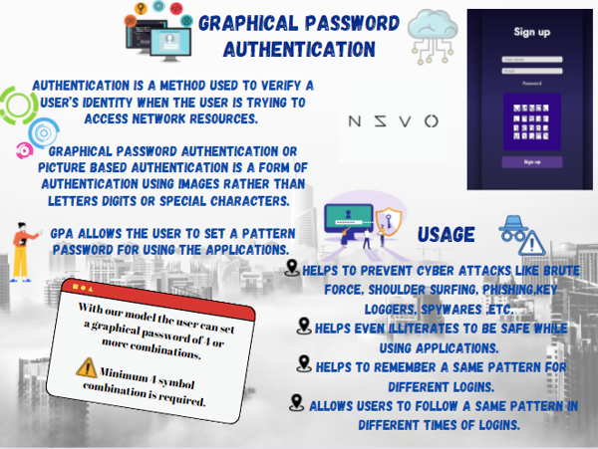
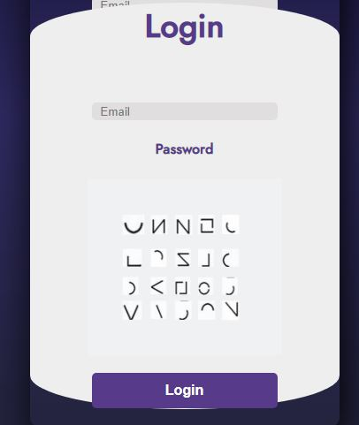

Slide 4
Team Member Details
Team Leader Name: Sailesh
Branch (Btech/Mtech/PhD etc): BSC Stream (ECE, CSE etc): Data Science Year (I,II,III,IV): I
Team Member 1 Name: Surya Rajiv Kumar
Branch (Btech/Mtech/PhD etc): BSC Stream (ECE, CSE etc): Data Science Year (I,II,III,IV): I
Team Member 2 Name: Sarvesh Ram
Branch (Btech/Mtech/PhD etc): BSC Stream (ECE, CSE etc): Data Science Year (I,II,III,IV): I
Team Member 3 Name: Indra
Branch (Btech/Mtech/PhD etc): BSC Stream (ECE, CSE etc): Data Science Year (I,II,III,IV): I
Team Member 4 Name: Ajay
Branch (Btech/Mtech/PhD etc): BSC Stream (ECE, CSE etc): Data Science Year (I,II,III,IV): I
Team Member 5 Name: Sudharshan Vijay.S.K
Branch (Btech/Mtech/PhD etc): BSC Stream (ECE, CSE etc): Data Science Year (I,II,III,IV): I
Team Mentor 1 Name: Lekha J
Category (Academic/Industry): Sri Krishna Institutions Expertise (AI/ML/Blockchain etc):Data Science Domain Experience (in years): 16.

